Slide 1


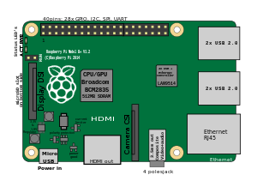

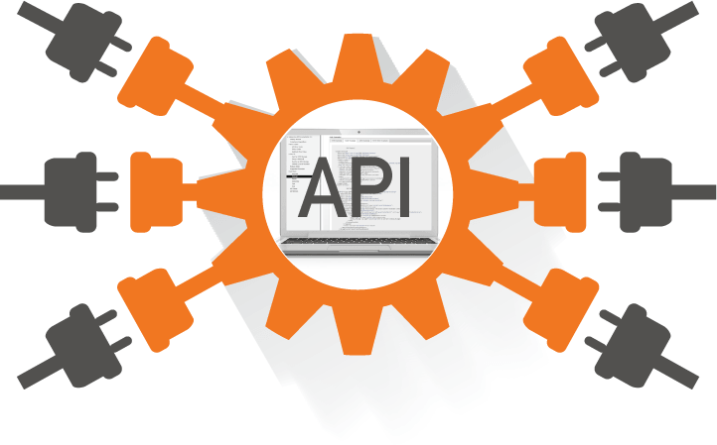
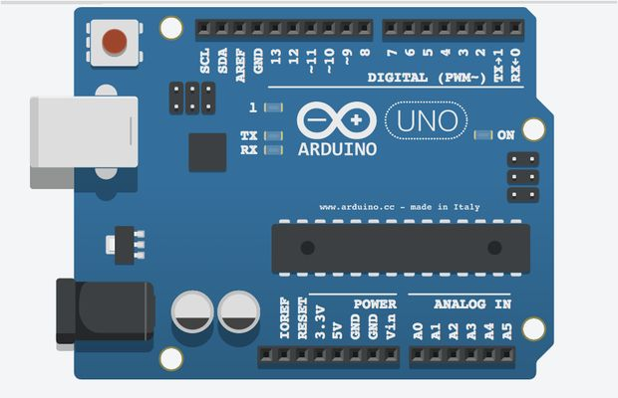

HTTP and Postman

Slide 2

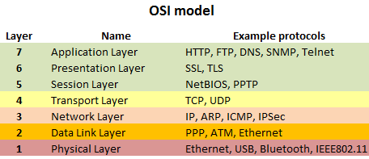
Introduction
Hypertext Transfer Protocol (HTTP)
application-level protocol
distributed, collaborative, hypermedia information systems
The foundation for data communication for the World Wide Web since 1990
HTTP is generic and stateless protocol
used for different purposes based on its request methods, error codes, and headers
Basically, it is a TCP/IP based communication protocol, used to deliver data (HTML files, image files, query results, etc.) on the World Wide Web
The default port is TCP 80, but other ports can be used as well
Provides a standardized way for computers to communicate with each other
HTTP specification:
how clients request data will be constructed and sent to the server
how the servers respond to these requests

Slide 3
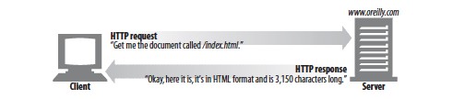
Basic features
Connectionless
client initiates requests and waits for the response
server processes the request and sends a response back
after that client disconnect the connection is closed
client and server knows about each other during current request and response only
Media Independent
any type of data can be sent by HTTP as long as both the client and the server know how to handle the data content
it is required only to specify the content type using appropriate MIME-type
Stateless
server and client are aware of each other only during a current request
afterwards, both of them forget about each other
neither the client nor the server retains information between different requests

Slide 4

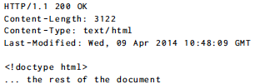
Elements
HTTP protocol version
Method: GET, POST, PUT, DELETE
REQUEST
Path of the resource the request applies to (can be a file, or anything that can be transferred as if it is a file). It can be generated on the fly
Headers: lines in the form “name: value” to specify extra information (e.g. the content type)
RESPONSE
Status code (200 mean succeeded, 4XX something wrong in the request, 5XX an error happened on the server )
Body containing the data being sent (GET and DELETE no body, POST and PUT yes)

Slide 5
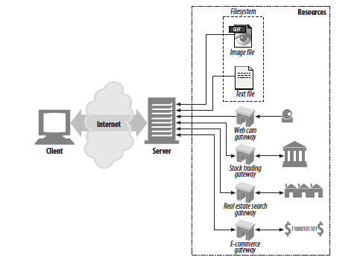
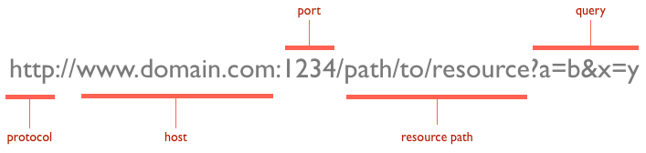
Resources, URLs and Verbs
Resource
the target of a request, which nature isn't defined further
it can be a document, a photo, or anything else!
Uniform Resource Locator (URL)
the identity of the particular resource
Verbs
the action that should be performed on the resource specified via URL
HTTP has formalized a few verbs that capture the essentials that are universally applicable for all kinds of applications
GET, POST, PUT, DELETE, etc.

Slide 6
Status Codes
Tells the client how to interpret the server response
HTTP spec defines a number ranges for specific types of responses
2xx: Successful
the request was successfully processed
200 OK, 202 Accepted, 204 No Content, 205 Reset Content 206 Partial Content
3xx: Redirection
requires the client to take additional action (e.g. jump to a different URL)
301 Moved Permanently, 303 See Other, 304 Not Modified
4xx: Client Error
the server thinks that the client is at fault
404 Not Found, 400 Bad Request, 401 Unauthorized, 403 Forbidden, 405 Method Not Allowed
5xx: Server Error
used to indicate a server failure while processing the request.
500 Internal Server Error, 501 Not Implemented, 503 Service Unavailable

Slide 7
Headers
Allow client and server to pass additional information
list of case-insensitive name ':' value pairs
Grouped according to their contexts:
General header
applying to both requests and responses
with no relation to the data transmitted
Entity header
information about the body of the entity
like its content length or its MIME-type
Request header
Response header
IANA registry
https://www.iana.org/assignments/message-headers/message-headers.xhtml

Slide 8
Message Body
Used to carry the entity representation associated with the request or response
it carries the actual HTTP request data (including form data and uploaded, etc.)
and HTTP response data from the server ( including files, images, etc.).
it is optional
HTTP is agnostic about the format of the message body
“Content-Type” and “Content-Length” headers specify the body nature
MIME (Multipurpose Internet Mail Extensions)
standard to indicate the nature and format of a document, file, or assortment of bytes
https://www.iana.org/assignments/media-types/media-types.xhtml
consists of a type and a subtype, concatenated with a slash
types: application, audio, font, text, image, video, etc.
subtypes: text/plain, text/html, image/jpg, application/json

Slide 9
HTTP Message
The request/response message consists of:
request line, such as GET /logo.gif HTTP/1.1 or Status line, such as HTTP/1.1 200 OK,
headers
an empty line
optional HTTP message body data
Example:
Request GET /pi/sensors/temperature HTTP/1.1
Host: devices.webofthings.io
Accept: application/json
cache-control: no-cache
Response HTTP/1.1 200 OK
Date: Mon, 11 March 2019 23:26:07 GMT
Server: Apache/2.2.8 (Ubuntu) mod_ssl/2.2.8 OpenSSL/0.9.8g
Last-Modified: Mon, 11 March 2019 23:26:07 GMT
ETag: "45b6-834-49130cc1182c0"
Content-Length: 168
Connection: close
Content-Type: application/json
{"name":"Temperature Sensor","description":"A temperature sensor.","type":"float","unit":"celsius","value":25.4,"frequency":5000,"timestamp":"2019-03-11T10:51:43.488Z"}

Slide 10
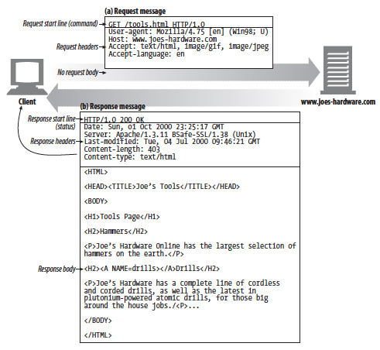
Complete example

Slide 11
Content Negotiation
Mechanism to ask for a specific type or representation by a client
“Accept” header in the request
specify the desired representation
is possible to have multiple values, with ratings
The server will supply the version of the resource that best fits the user needs
Example:
Accept: application/json; q=1.0, application/xml; q=0.8, */*; q=0.1
ask a JSON format, if it can’t, perhaps it could return XML format (the second level), If it’s still not possible, let it return what it can...

Slide 12
Caches
To eliminate the need to send requests in many cases, and to eliminate the need to send full responses in many other cases
Mechanisms
implicit directives to caches where server specifies expiration times and validators
Cache-Control header
No-Store: client aren’t allowed to cache a response and must pull it each time
Max-Age: defines the amount of time it takes for a cached copy to expire
Public: a resource can be cached by any cache
Private: a user specific resource, it can be cached, but only on a client device
Additional HTTP Cache Headers
Expires: specifies a fixed date/time for the expiration of a cached resource, ignored when a max-age directive is present
ETag: identifies the version of served content according to a token (a string) that changes after a resource is modified. Can be used to validate a local resource

Slide 13
JSON
JavaScript Object Notation (JSON)
easy to read and write both for human and machine
open-standard file format
https://tools.ietf.org/html/rfc8259
Basic syntax
data is represented in “name : value” pairs
the name/value pairs are separated by comma
types: number, string, boolean, object, array, null
curly braces hold objects
square brackets holds array
Parsing
from JSON to language (Java/C#/Javascript) object
in JavaScript, you can easily parse JSON data using the JSON.parse() method
parses the string and constructs the JavaScript object described by the string
// Store JSON data in a JS variable
let json = '{"name": "Peter", "age": 22, "country": "United States"}';
// Converting JSON-encoded string to JS object
let obj = JSON.parse(json);
// Accessing individual value from JS object
console.log(obj.name);

Slide 14
HTTP and the Browser
A browser will make a GET request on the URL in its address bar
If the resulting HTML references other files (e.g. images, JS files, etc.) then the browser will GET also these resources simultaneously
HTML page can include forms to build method requests:
<form method="GET" action="example/message.html">
<p>Name: <input type="text" name="name"</p>
<p>Message: <textarea name="message"></textarea></p>
<p><button type="submit">Send</button></p>
</form>
When the button is pressed, the information in the fields are encoded into a query string and the form method (here GET) is requested:
GET /example/message.html?name=Jean&message=Yes HTTP/1.1
A button
Two fields (text and textarea)
Query string, it starts with a question marks, then follow pairs of “name=value” separated by &

Slide 15
HTTP and the Browser
If we change the method in the form with POST
the request will use POST
the query string will be moved in the body
POST /example/message.html HTTP/1.1
Content-length: 24
Content-type: application/x-www-form-urlencoded
name=Jean&message=Yes
Important HTTP conventions:
GET is used for request that do not have side effects (e.g. doing a search)
safe and idempotent (can be applied multiple times without changing the result)
POST is used for request that change something on the server (e.g. posting a message)
non-safe and non-idempotent
Browsers can make HTTP request from JS with XMLHttpRequest()
designed by Microsoft in 90s (when XML was very popular)
bad design: it confuse two distinct concepts (making a request and parsing the response)
Code: 01.HTTPRequest.js

Slide 16
Asynchronous Requests
Synchronous requests block the execution of code which creates "freezing" (e.g. unresponsive user experience)
when connection is bad, the server is slow and the file is big…
XMLHttpRequest() supports also asynchronous communications
Code: 02.AsyncHTTPRequest.js
When we call “send” the request gets scheduled to be sent
the program can continue
the browser will take care of the sending and receiving of data in the background
but as long as the request is running, we won’t be able to access the response
We must listen for the "load" event on the request object
Asynchronous style of programming
wrapping the things that have to be done after the request in a function
arranging for that to be called at the appropriate time
We will see more on that with Node.JS

Slide 17
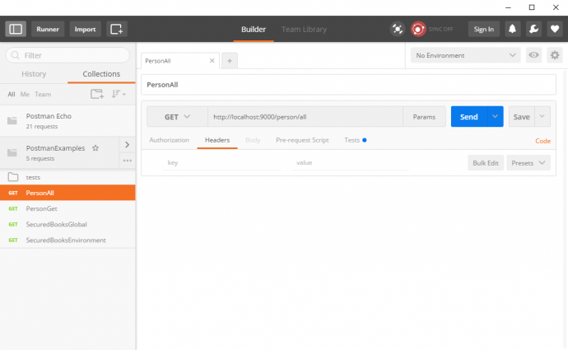
Postman
An application used to fire HTTP requests
lightweight and fast
requests can be organized in groups
tests can be created with verifications for certain conditions on the response
Support HTTP
different kinds of HTTP requests (GET, POST, PUT, PATCH and DELETE)
add headers to the requests
More interesting features:
variables
pre-request script
tests

Slide 18
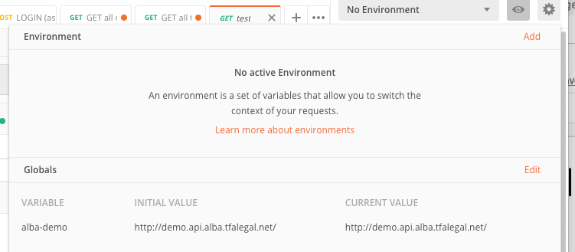
Postman: variables
Two types of variables: global and environment
global variables are for all requests
environment variables are defined per specific environment
selected from a drop-down
Editable by a small eye-shaped icon in the top right corner
Once defined variables can be used in a request with format surrounded by curly brackets {{VARIABLE_NAME}}
Example: set a variable “url” with value “https://jsonplaceholder.typicode.com”

Slide 19
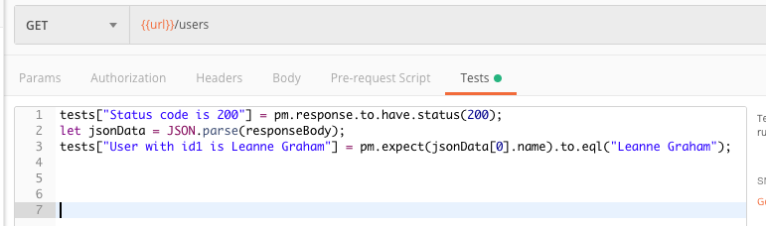
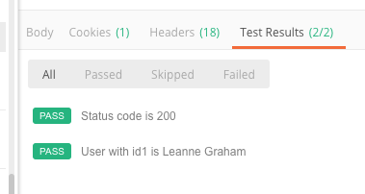
Postman: Tests
After a response is received, Postman has a functionality to make verifications on it
done in “Tests” tab
JSON response can be parsed and properties accessed by some JavaScript code
Test are written in the format
tests[“TEST_NAME”] = BOOLEAN_CONDITION
Example:
make GET over “{{url}}/users
check if the status code is 200
Check if the list of user contains a specific user

Slide 20
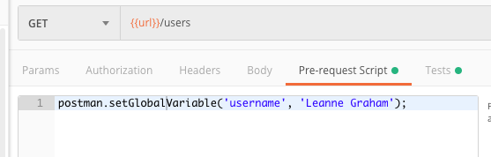
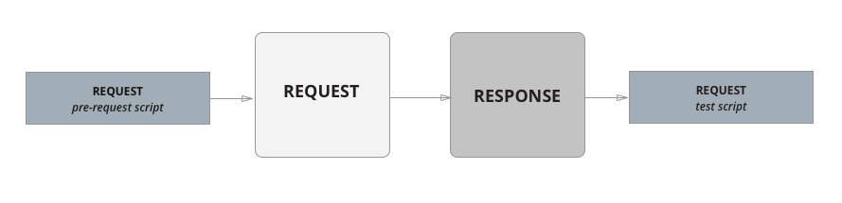
Postman: Pre-Request Script
To do JavaScript coding to manipulate the data being sent with the request

Slide 21
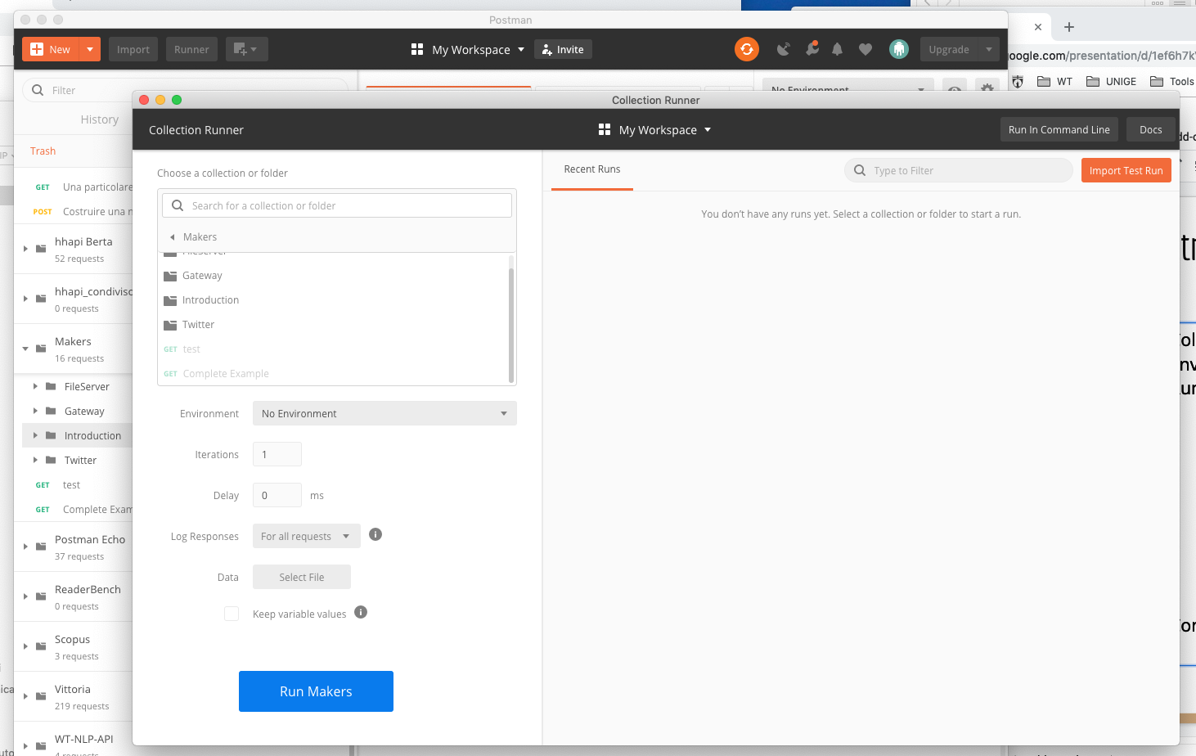
Postman: more...
Collections
Environment
Runner
Complete example: 0.3.Makers.postman_collection.json

Slide 22
Hands-on Activity
Create a Postman collection to test the API that you can find at the following link https://jsonplaceholder.typicode.com/. You have to post some “comments” and get a list of previous “posts”

